Slide 1

Active learning strategies for improving student learning and engagement
Sahana Murthy
IDP in Educational Technology
Indian Institute of Technology Bombay
Colloquium at Dept of Electrical Engineering, IIT Bombay
November 4, 2015

Slide 2
How engaged are your students?
Consider a large class. Example: EE 111/ 112 (N ~ 150?), CS 101 (N~250 per section)
Imagine a 90-minute class in a large auditorium with fixed seats.
Think (Individually):
Predict the percentage of students who may be showing “engaged” behaviour (with the content of the lecture), at various instants of time.
Draw a graph of engagement versus time. [~1 min]
Percentage of
students engaged
% e
t (Time instant of lecture)

Slide 3
How engaged are your students?
Consider a large class. Example: EE 111/ 112 (N ~ 150?), CS 101 (N~250 per section)
Imagine a 90-minute class in a large auditorium with fixed seats.
Think (Individually):
Predict the percentage of students who may be showing “engaged” behaviour (with the content of the lecture), at various instants of time.
Draw a graph of engagement versus time. [~1 min]
Pair (with your neighbour):
Examine each other’s graphs. [~1 min]
Together, come up with two techniques that could be used to convert your graph into something that looks like the figure shown. [~3 min]
0.8
% e
t

Slide 4
How engaged are your students?
Consider a large class. Example: EE 111/ 112 (N ~ 150?), CS 101 (N~250 per section)
Imagine a 90-minute class in a large auditorium with fixed seats.
Think (Individually):
Predict the percentage of students who may be showing “engaged” behaviour (with the content of the lecture), at various instants of time.
Draw a graph of engagement versus time. [~1 min]
Pair (with your neighbour):
Examine each other’s graphs. [~1 min]
Together, come up with two techniques to convert your graph into something that looks like the figure. [~3 min]
Share (entire audience):
Discuss pros and cons of some techniques. [~2 min each]
Identify top three techniques that are likely to “succeed”. [~3 min]
0.8
% e
t

Slide 5
How to maintain students’ engagement?
Active learning.

Slide 6
My lectures are plenty interactive!
I often pause to ask students if they understood the material
I allow students to interrupt whenever they have doubts
I never hesitate to answer their questions
I show them demos and videos
….
Isn’t this active learning?

Slide 7
Requirements of active learning strategies
Instructor creates carefully designed activities that require students to talk, write, reflect and express their thinking.
Students go beyond listening, copying of notes, execution of prescribed procedures.
Explicitly based on theories of learning.
Evaluated repeatedly through empirical research.
D. E. Meltzer and R. K. Thornton. "Resource letter ALIP–1: active-learning instruction in physics." Am. J. Phys, 80.6 (2012): 478-496

Slide 8
Why bother with (strict defn of) active learning?
I often pause to ask students if they understood the material
I allow students to interrupt whenever they have doubts
I never hesitate to answer their questions
I show them demos and videos
I spend a lot of time preparing lectures.
I deliver my lectures smoothly
Aren’t these enough?
Necessary but not sufficient.
Why not?

Slide 9
Why ‘interactive lectures’ may not be enough
Students don’t pay utmost attention throughout the lecture.
Students think that they understand because they can follow the lecture.
- They are not confronted with their misconceptions immediately.
Difficult to ensure that all students in the class participate actively.
Students with high motivation / achievement levels drive the pace
Students with low achievement levels get left behind.
Students have a barrier to responding directly to the instructor.
Shy students don’t ask questions, or give answer, even if they have one.
Forcing all students to respond tends to be counter-productive.

Slide 10
Why ‘interactive lectures’ may not be enough
Students don’t pay utmost attention throughout the lecture.
Students think that they understand because they can follow the lecture.
- They are not confronted with their misconceptions immediately.
Difficult to ensure that all students in the class participate actively.
Students with high motivation / achievement levels drive the pace
Students with low achievement levels get left behind.
Students have a barrier to responding directly to the instructor.
Shy students don’t ask questions, or give answer, even if they have one.
Forcing all students to respond tends to be counter-productive.
But … is there data? Evidence?
Let’s examine some empirical results.

Slide 11
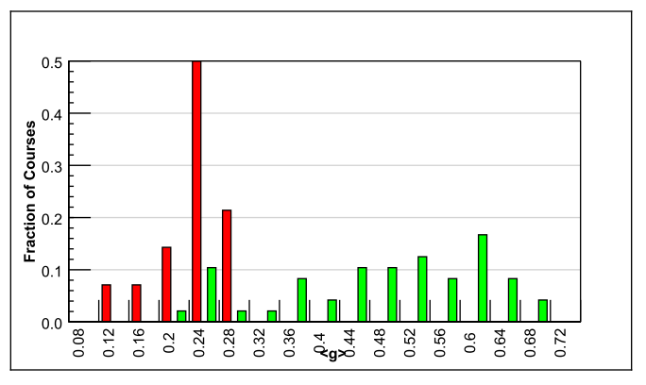
Evidence for active learning – 1
Comparative study of 62 Physics courses (1998)
6542 students
Variety of institutions: high school, college, university
Test of conceptual reasoning – Force Concept Inventory
Pre-post, semester long
Trad lecture (14)
Active learning strategies (48)
Normalized gain
<g> = ^{post-pre} ^{100-pre}
IMPLICATION
Desirable to explicitly incorporate active learning strategies in our teaching-learning.
RESULTS:
Maximum gain from lecture courses was 0.28
- Many instructors had high scores on teaching evaluations
Gain from active-learning courses had a wide range: 0.23-0.7
- AL courses had gains 2-3 times greater than lectures
R. Hake, “Interactive-engagement versus traditional methods: A six-thousand student survey of mechanics test data for introductory physics courses” Am. J. Phys., 66 (1998)

Slide 12

Evidence for active learning – 2
Proc. Natl. Acad. Sc, 111(23), 2014
Meta-analysis of 225 studies (2014)
Exam performance: higher by 0.47 standard deviations in active learning courses– ~ 1/2 letter grade average increase.
Failure rates : 33.8% in traditional classes vs 21.8% in active learning courses
Results hold across STEM disciplines, majors and non-majors, lower- and upper-division courses.
Effect sizes greater for concept inventories than for instructor-written exams.

Slide 13
Features of active learning strategies
Students engage in problem-solving activities during lecture.
Students work collaboratively.
Students are asked to “ﬁgure things out for themselves.”
Students are asked to express their reasoning explicitly.
Qualitative reasoning, conceptual thinking are emphasized.
Speciﬁc student ideas are elicited and addressed.
Students receive rapid feedback on their work.
Ensure (most) students participate
Target misconceptions
“… think they understand” ==>
“… know whether or not understand”

Slide 14
How can an instructor do active learning?
Some strategies:
Peer-Instruction (Eric Mazur, Harvard University, early 1990s)
Think-Pair-Share (Frank Lyman, University of Maryland, early 1980s)
Many others:
(lecture) Team-Pair-Solo, Problem-based learning, Just-in-Time-Teaching, Role-play, Jigsaw, Case-based learning, Peer-review, Productive failure …
(lab) Pair programming
(tutorial) TPS, TPS, PBL, Data-based problem solving
Flipped classroom – with one of the above

Slide 15
Peer Instruction

Slide 16
Vote individually
An object floats in water but sinks in oil. When it floats in water it is exactly halfway submerged.
If we slowly pour oil on top until the oil completely covers the object, does the object:
Move up
Stay in place
Move down
?

Slide 17
Convince your neighbor
An object floats in water but sinks in oil. When it floats in water it is exactly halfway submerged.
If we slowly pour oil on top until the oil completely covers the object, does the object:
Move up
Stay in place
Move down
?

Slide 18
Converge … and vote again
An object floats in water but sinks in oil. When it floats in water it is exactly halfway submerged.
If we slowly pour oil on top until the oil completely covers the object, does the object:
Move up
Stay in place
Move down
?

Slide 19

Peer Instruction Anatomy
Ask Question
(May vote individually)
…Lecture…
Debrief /
Class Discussion
Peer Discussion
Vote
Figure attributed to: Stephanie Chasteen and the Science Education Initiative at the University of Colorado
19

Slide 20


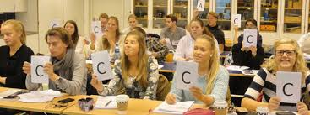

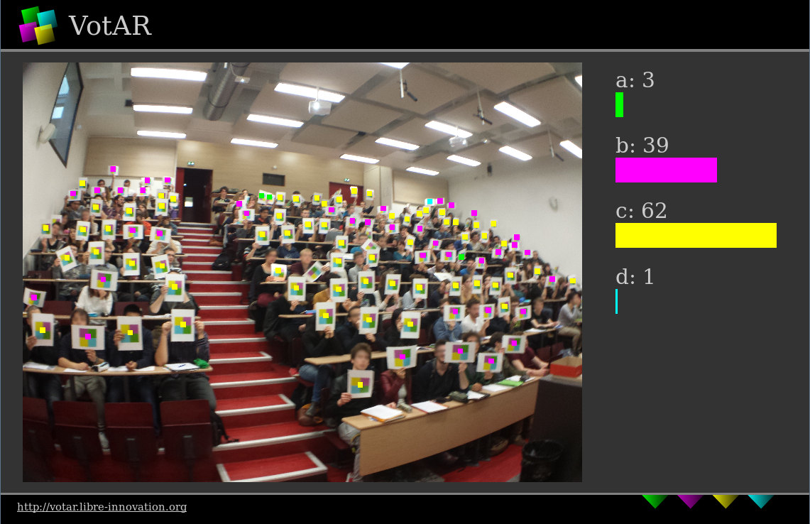
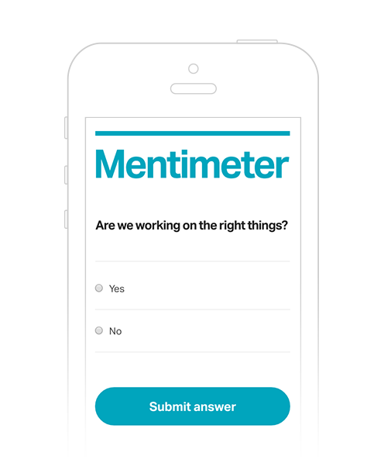



Implementation of Peer-Instruction
www.votar.libre-innovation.org
www.mentimeter.com

Slide 21
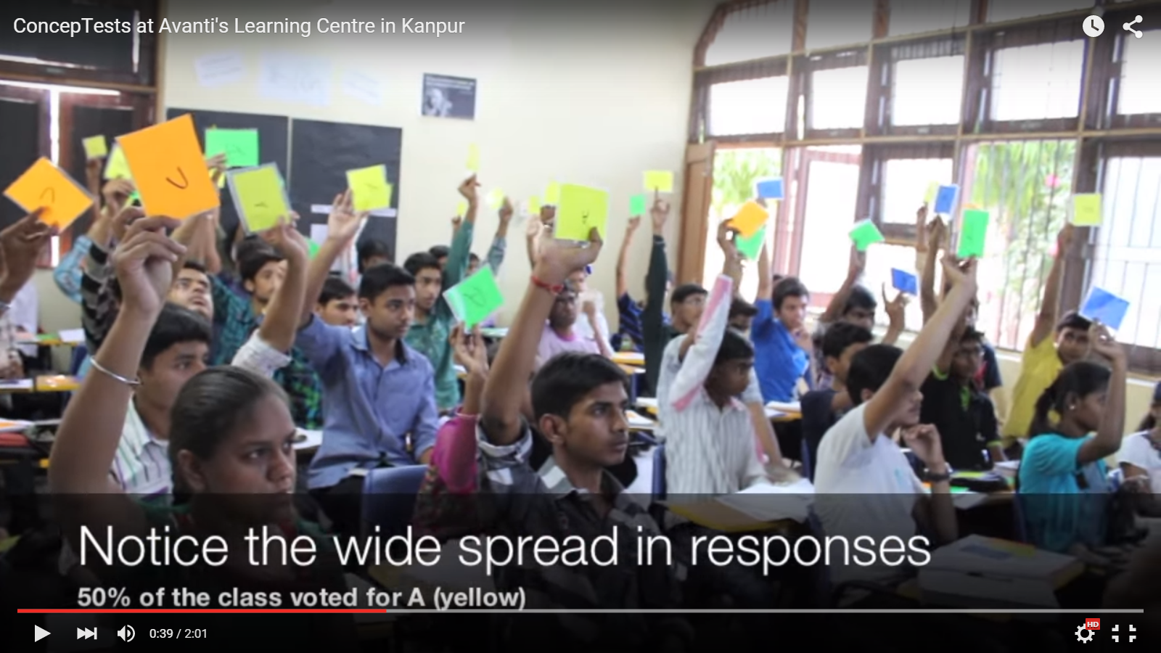
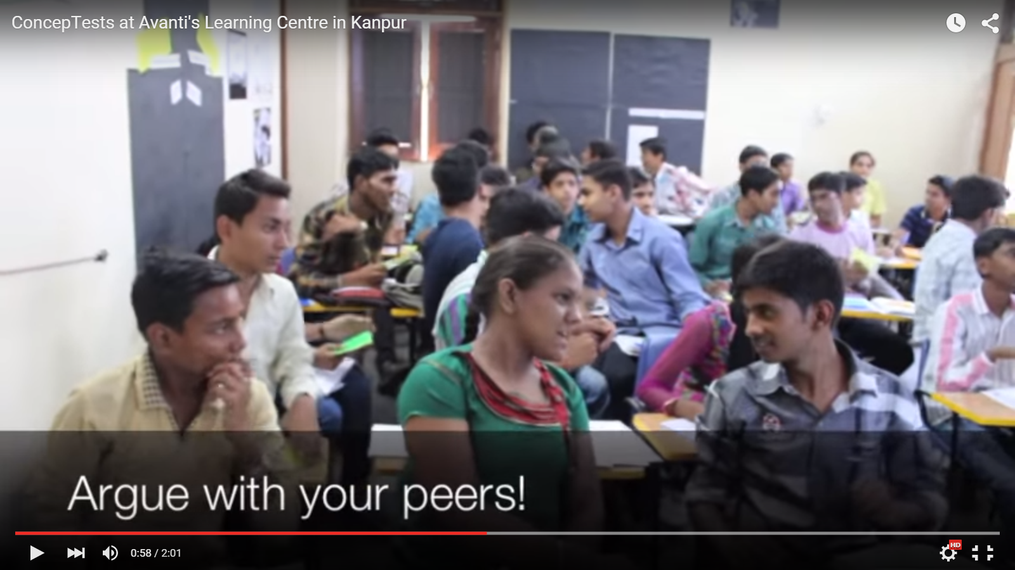

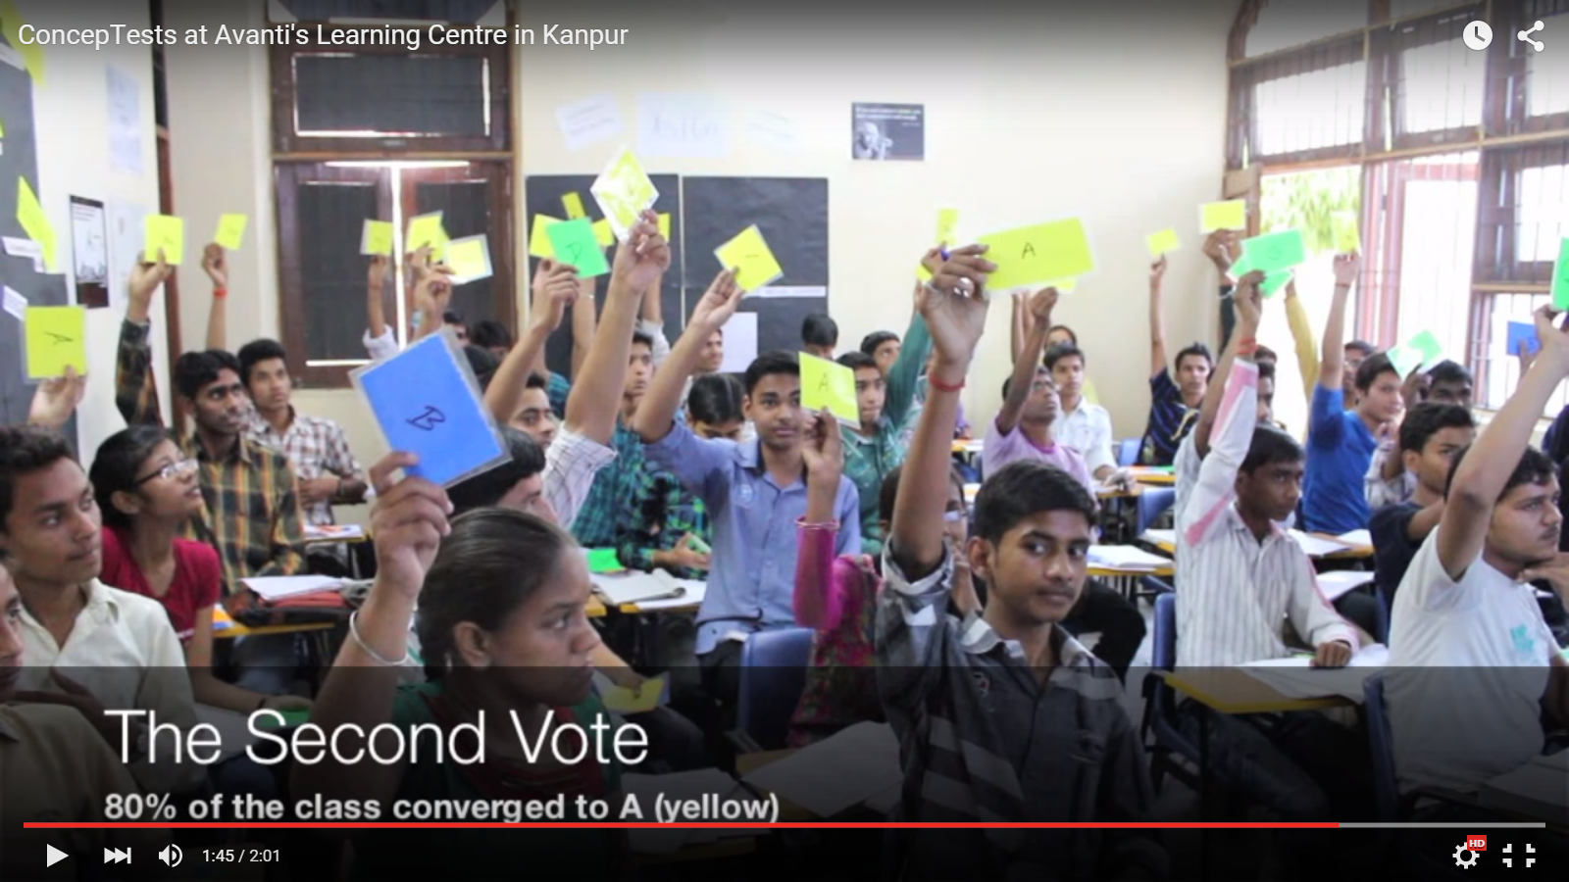
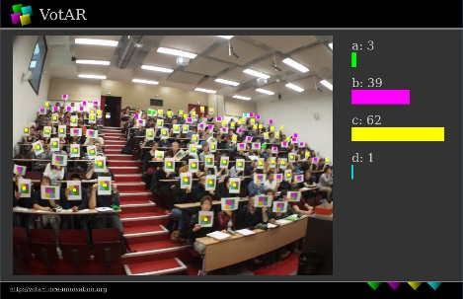
Implementation of Peer-Instruction

Slide 22
Example – Conceptual reasoning
A parallel plate capacitor is charged to a total charge Q and then the battery is removed. A dielectric slab is inserted between the plates.
What happens to the energy stored in the capacitor?
Increases
Decreases
Stays the same
I need more info to answer

Slide 23

Example - Predict the outcome (of an expt, video)
A helium balloon is attached to a string tied to the bottom of a cart on wheels. The sides of the cart are encased in clear plastic. A person will abruptly push the cart to the
left. Will the balloon move?
Yes, to the left
Yes, to the right
No
Let students vote, only then show movie for what happens.
http://paer.rutgers.edu/pt3/experiment.php?topicid=13&exptid=121

Slide 24
Example – Reasoning with representations
Which circuit will satisfy the given input-output relationship?
1.
2.
3.
4.

Slide 25
Example - survey
I think the toughest thing about using peer instruction in my class will be:
1. Writing good questions
2. Getting students to answer seriously
3. Getting students to share their reasoning with the whole class
4. It takes too long / I have a lot of content to cover

Slide 26
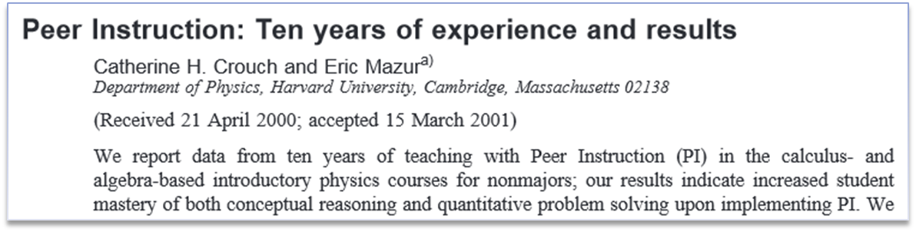
Research on Peer Instruction
300+ studies in various domains
Meta-analyses
Several measures:
- conceptual understanding, problem solving, attendance, motivation, learning from peers, student perceptions of

Slide 27
Peer-instruction – some guidelines
WRITING. A ‘good’ PI question is:
Is usually conceptual
Avoid long analytic computation
Avoid number crunching
Elicits pre-existing thinking, conceptions
Asks students to predict results / output
Relates different representations
Has believable distractors
Is not ambiguous, leading or ‘trivial’
CONDUCTING PI in class:
Do not skip the peer discussion part
Focus on reasoning not only on right answer.
Avoid giving ‘rapid rewards’ (nodding)
Ask multiple students to give answers.
Discuss reasons for right & wrong answer
Time - 2-5 min per question.
Frequency - a “few” per class, 2-4.
Credit - Do not assign heavy credit for right / wrong answers (“whiff” of credit for participation ok)

Slide 28
Think-Pair-Share (recall first activity – predict engagement)

Slide 29
Think-Pair-Share – what & how
Students work on a series of questions posed by instructor
Think: Teacher asks a specific question about the topic. Students "think" about what they know or have learned, and write their own individual answer to the question. [Takes 1-3 Minutes].
Pair: Teacher asks another question, related to the previous one, that is suitable to deepen the students’ understanding of the topic. Each student pairs with another. They discuss their “think” answers and reasoning with each other and proceed with the task. [Takes 5-10 Minutes].
Share: Students share their solutions and reasoning with the entire class. Teacher moderates the discussion and highlights important points. [Takes 10-20 minutes].

Slide 30
Think-Pair-Share – Example – Conceptual reasoning
A student was sampling a sinusoid with frequency fm=10kHz with a sampling frequency fs=30kHz. Later she added one more sinusoid of frequency fm=20kHz to the original.
Think: Will she be able to analyze the signal properly? Why / why not?
Pair: Together with your neighbor: i) Do you agree with neighbor’s answer? ii) Come up with possible rectifications the above student could make.
Share: Participate in discussion of your solution and others.
Question adapted from Prof V M Gadre and Abhinav Anand

Slide 31
Think-Pair-Share – when
Multiple valid approaches to solving a problem
Pros-cons analysis
Multi-step / multi-process problem solving
Design a solution to a complex problem

Slide 32
Think-Pair-Share – Example – Design a solution
“Design a taxi scheduling service for an airport as follows:
When a driver arrives, his ID is entered in an array
When a customer arrives the earliest waiting driver is assigned
Think: What structures and variables are required?
Pair: Come up with the pseudo-code for the functions that are required.
Share: : Follow instructor led discussion of your solutions and others.
Question from CS101, Spring 2014

Slide 33
Think-Pair-Share – some guidelines
Three points to keep in mind:
Ensure that there is a clear ‘deliverable’ for each phase. This drives the action in that phase.
Ensure that the phases are logically connected. They should use the output of one phase in next.
Ensure that there is sufficient time for each phase.
Too little ==> Frustration; Too much ==>Boredom.
Move on when 80% of the class has finished

Slide 34
Active learning in IITB courses – Research results

Slide 35
Research studies on active learning techniques
 | COURSE | ACTIVE LEARNING STRATEGY | RESULT
CS101 | Intro to computer prog. 2013 & -14 Prof Sridhar Iyer | Think-Pair-Share, Peer Instruction | 83% students engaged (observation protocol) Higher learning than lecture (controlled expt) High student perception (survey, course eval)
EE 590 | Foundations of projects 2014 Prof Bipin Rajendran | GPGP – Guided Problem-solving and Group Programming | Significant pre-post gain on problem-solving skills; High perception of learning
EE 746 | Neuromorphic engg 2013 Prof Bipin Rajendran | Delayed Guidance – in-class ill-structured problem solving | Higher problem solving skills compared to traditional methods (controlled expt); Wider range of problem solving heuristics
CS 213 | Data structures and algos. 2014 Prof Ganesh Ramakrishnan | Think-Pair-Share | Relative gain twice for TPS topic than traditionally taught topic Majority students wanted more TPS topics
CS 716 | Intro to computer networks 2009, -10, -11, Prof Sridhar Iyer | Analogical problem solving, TPS, TPS | Students able to apply concepts from real life to solve networking problems in new unseen topic
CL 692 | Digital control 2009, Prof Kannan Moudgalya | Flipped Classroom (before phrase became popular) | Students perceive VoD, Moodle useful for learning, Perceptions depend on student & instructor competency with ICT, notions of “learning”.

Slide 36
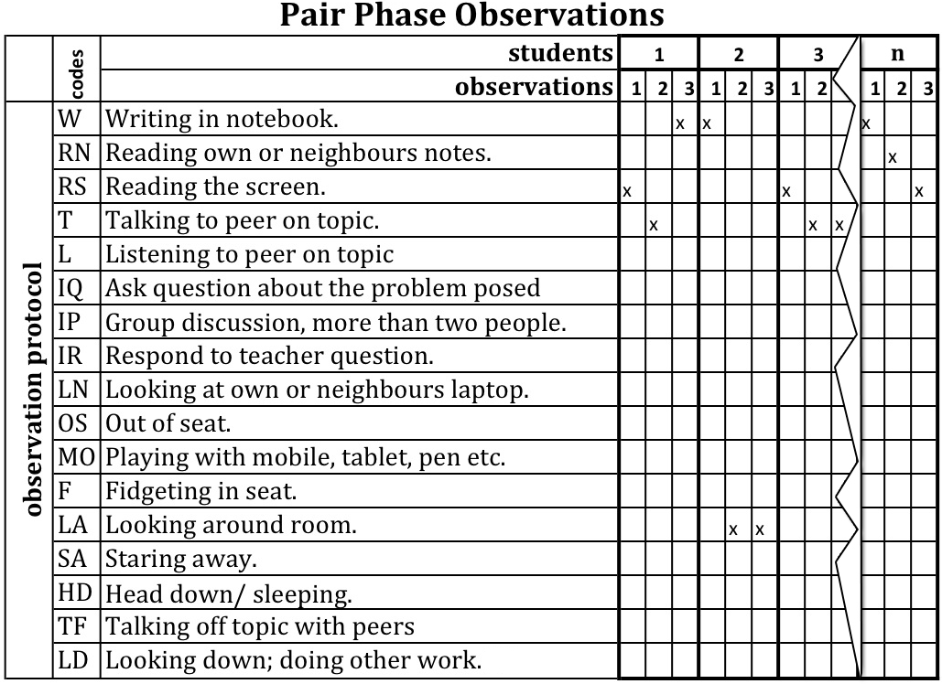
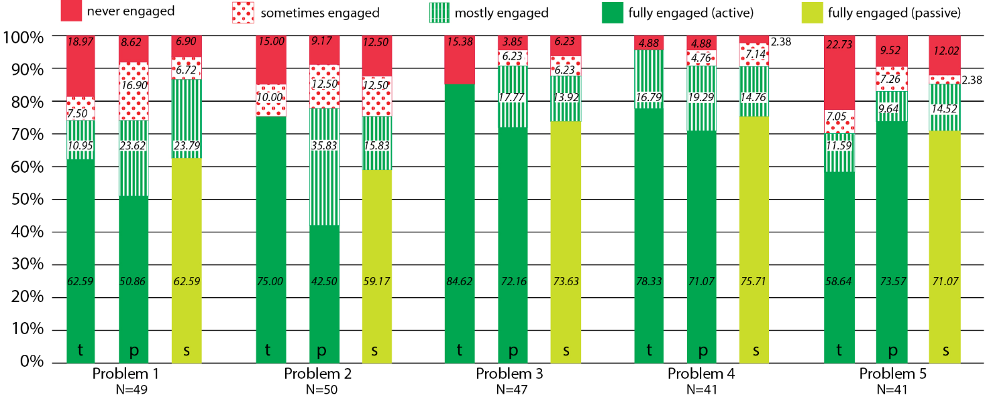
Measuring student engagement and learning - CS101
Observation Protocol
Overall engagement across T, P, S (N=228). Av. = 83%
Experimental group Mean (N-250) | Control group Mean (N=169) | p
1.91 (1.65) | 0.88 (1.3) | 0.001**
Learning – problem solving test, 2 groups
Scores of TPS group higher than control group
A. Kothiyal, R. Majumdar, S. Murthy and S. Iyer, “Effect of Think-Pair-Share in a large CS1 class: 83% sustained engagement” ACM International Computing Education Research (ICER), San Diego, 2013

Slide 37
Measuring student learning and perception – EE 590
Scoring rubric for open ended problem solving
Problem-solving skill | Sub-Skill | Pre-score | Post-score | p
1) Representing problem | a) Define the problem b) Generate sub goals c) Identify relevant information d) Seek needed information | 2.7 | 4.5 | 0.004**
2) Developing solution | a) Selecting solution approach b) Quality of solution | 2.3 | 3.9 | 0.011*
3) Making justifications | a) Constructing argument b) Providing evidence | 2.8 | 3.5 | 0.012*
4) Monitoring and evaluating solution | a) Evaluating solution(s) b)Assessing alternate solution(s) | 0.3 | 0.7 | 0.12
Post test scores higher than pre-test, statistically significant for Skills 1, 2, 3
Survey questions | Agree | Neutral | Disagree
Q.1 | 58.82 | 35.29 | 5.88
Q.2 | 88.23 | 11.77 | 0
Q.3 | 70.58 | 29.42 | 0
Abhinav Anand, Aditi Kothiyal, Bipin Rajendran & SM - Guided Problem Solving and Group Programming - A Technology-Enhanced
Teaching-Learning Strategy for Engineering Problem Solving, IEEE International Conference on Technology for Education, T4E 2014.

Slide 38
Why do active learning techniques work?
What do students do? Talk, argue, listen (sometimes), reason, draw, … ==> engaged with content Learn from each other, teach each other (teach<=>learn) Those who don’t know are willing to think, reason, answer Those who do know are willing to participate (teach? show-off?) Pre-existing thinking is elicited, confronted, resolved
What are other benefits? To instructor? To class atmosphere Immediate feedback to instructor Students realize that even others are struggling Builds a friendly, yet scientific atmosphere Improves communication

Slide 39
Flipped Classroom

Slide 40
Flipping the classroom - From
Information Transmission
In class
Assimilation
Outside class

Slide 41
Flipping the classroom - From
Information Transmission
In class (lecture)
Assimilation
Outside class (HW problems)

Slide 42
Flipping the classroom - To
Information Transmission
In class
Assimilation
Outside class

Slide 43
Flipping the classroom - To
Information Transmission
In class
(active learning)
Assimilation
Outside class
(videos, reading)

Slide 44
Example – Flipped class
Course: Communication Networks; Topic: IP Addressing
Pre-class activity (home) – Watch a video that describes a basic mechanism for assigning IP addresses in a network.
In-class activities:
Peer Instruction questions on IP address classes.
Debate pros and cons of hierarchical addresses.
Think-Pair-Share to design solutions to reduce inefficient use of address space.

Slide 45
Flipped class - why
Class time is spent in assimilation (difficult), rather than information transmission (easier)
Class time is spent in higher cognitive levels (apply, analyze, create), rather than lower levels (recall, understand).
Support of peers and instructor is available while working on higher cognitive levels.

Slide 46
Guidelines – out-of-class
You can flip only a part of your course (say 2 weeks).
Try to use existing resources – MOOC videos, NPTEL, Spoken-Tutorial, …
Keep videos short.
Good idea to have some short self-assessment Qs along with videos
Provide incentives for students to prepare for class.
Plenty of how-to’s if you want to create your own technology

Slide 47
Guidelines – in-class
Not merely asking / getting clarifications
Not ‘going over’ information already present in video
Do structured active-learning strategies that require students to apply their learning (from out-of-class) and develop higher level thinking skills.

Slide 48
Good practices

Slide 49
Applicable for all active learning strategies
Get student buy-in.
Create it by explaining why you are doing this.
Better still demonstrate why you are doing this.
Try to follow an active learning strategy as prescribed, first
Know the research, then tweak if you’d like
Plenty of resources – use, and contribute ☺
www.et.iitb.ac.in --> Resources -->Teaching Strategies (PI, TPS activity constructors)
PI: CWSEI www.cwsei.ubc.ca/resources/clickers.htm , http://blog.peerinstruction.net/ (many how-tos)
Flipped Classroom: CfT Vanderbilt https://cft.vanderbilt.edu/guides-sub-pages/flipping-the-classroom/
Notes:
49

Slide 50
Education research study in your class?
If interested please get in touch.
(but will require some time + effort commitment from your end)
IDP-ET PhD students trained in education research methods can participate.
Thank you.
Notes:
50

